Slide 1
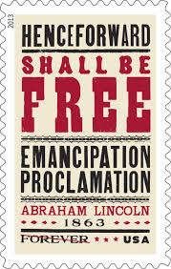
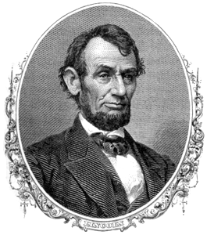
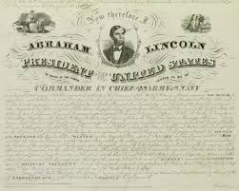
If Lincoln Had Not Freed the Slaves
The Inevitable Results of no Emancipation Proclamation
Tom Wicker

Slide 2
Background to the Emancipation Proclamation
September 22, 1862 Cabinet meeting “let’s take the moral high ground”
Military Victories of the North limited to the West
The Confederacy Victories at 2nd battle of Bull Run, stopped the Northern approach to Richmond the Confederate Capital and Lee was planning to invade Maryland and Pennsylvania.
Finally a Northern Victory at Antietam “bloodiest day in American history” to date.
There was a threat from England and France for a brokered peace.
The Emancipation Proclamation created a sense that the war was “a moral crusade against slavery!”
Lincoln in defense of the proclamation wrote: “if I could save the Union without freeing slaves I would do it and if I could save the Union by freeing the slaves than I would do that.”

Slide 3
What the Emancipation Proclamation Actually Did
Freed slaves in states under rebellion and in part of states in rebellion.
IT DID NOT free slaves in D.C. Northern states or slave border states like Kentucky that did not secede from the Union.

Slide 4
Lincoln – Father Abraham and the
“Great Emancipator”
180,000 new Black troops
The French and/or British recognition would have recognized “chattel slavery.”
McClellan might have won the 1864 election.

Slide 5
What Wicker Wondered
Would the civil rights been more violent? No emancipation, no constitutional amendment.
Gradual versus sudden emancipation. – compensation and resettlement in Africa
If recognition of the Confederacy had come, the Proclamation would have been seen as a war measure only and not as a moral measure?

Slide 6
Wicker’s Speculations
Slavery would have continued in South and border states
World opinion and the inefficiency of the slavery would have gradually ended it with compensation to the Slave owners.
No 13th (abolition), 14th (equal protection under the law), 15th ( right to vote regardless of race or color) amendments
No Ku Klux Klan born of Southern resentment of occupation
BUT the south would have maintained peonage “separate but equal” under sharecropping and under systems.
Probable reconciliation of North and South with a stalemate in the slave issue.

Slide 7
Wicker’s Psychological Conclusion
“In winning freedom for slaves more than a century ago, however, the nation finally accepted freedom for itself ….’’
It began the “unfinished work” and “the great task remaining before us.”

Slide 8
Questions
Do you think a more gradual emancipation would have been better?
What is the “unfinished work” left to be done?
Do you think that Wicker made a strong, modest or weak case about how influential the Emancipation Proclamation was?
Compare Obama’s endorsement of Gay Marriage to the Emancipation.
What other kinds of Proclamations ought to be made today?

